Slide 1
Decision Tree Classification
Chapter 19 (JW)

Slide 2
Introduction
A simple classification method that works well in practice
It is a partition-based method, can also be called a local method
It partitions the feature-space by axis-parallel hyperplane, so that the resulting set of partitions are as pure as possible
The partition feature is chosen with a greedy algorithm by a greedy criteria
Purity of a region is defined as the fraction of points with the majority label
Internal nodes represent the decision or split points
Leaf nodes represent regions of the data space labeled with the majority class
Over-fitting is controlled by pre-pruning or post-pruning of a tree branch

Slide 3
Introduction (cont.)
It is a good classifier, because
It is simple
The predictor is transparent
It is parameter-less
Availability
C5.0 software (http://www.rulequest.com/download.html)
Weka’s J48 algorithm (http://www.cs.waikato.ac.nz/ml/weka/)

Slide 4
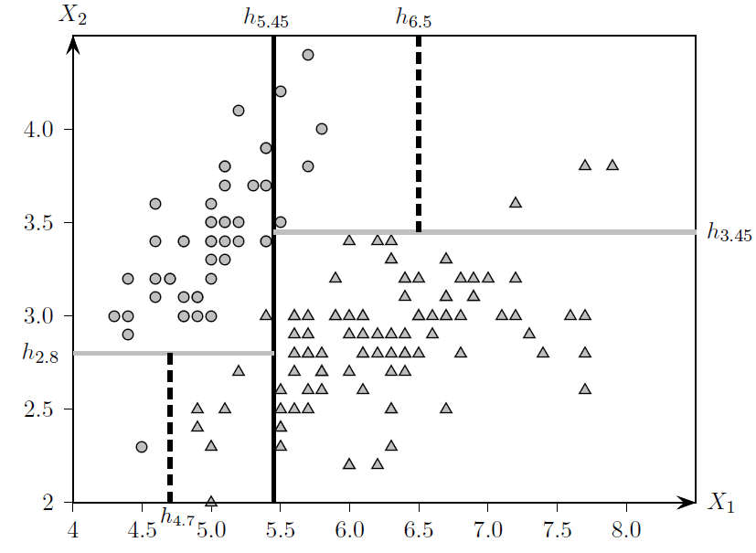
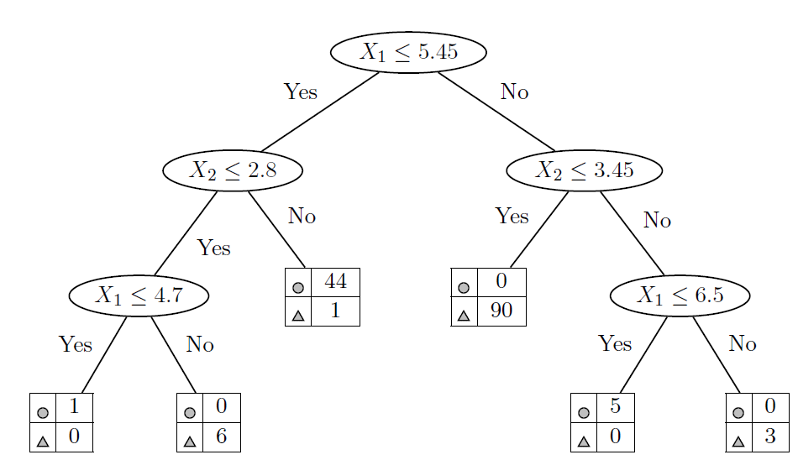
Example
Decision tree
Axis Parallel partition

Slide 5
Building decision tree
Select a feature using a greedy criteria called information gain and use it to partition the data space into two disjoint regions.
Each of the regions is recursively split until the points within a induced partition are relatively pure
The hierarchy of split decision can be shown as a tree, called a decision tree,
internal node of the tree are partition criteria
External node of the tree is a region in the data space which is given a label based on majority vote
For classifying a new test point, we simply find which partition the point belongs to and label the point with the label of that partition.

Slide 6
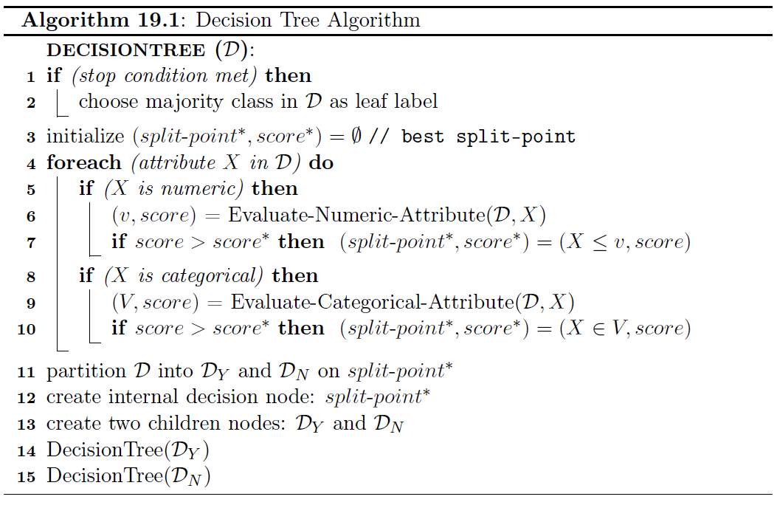
Decision Tree

Slide 7
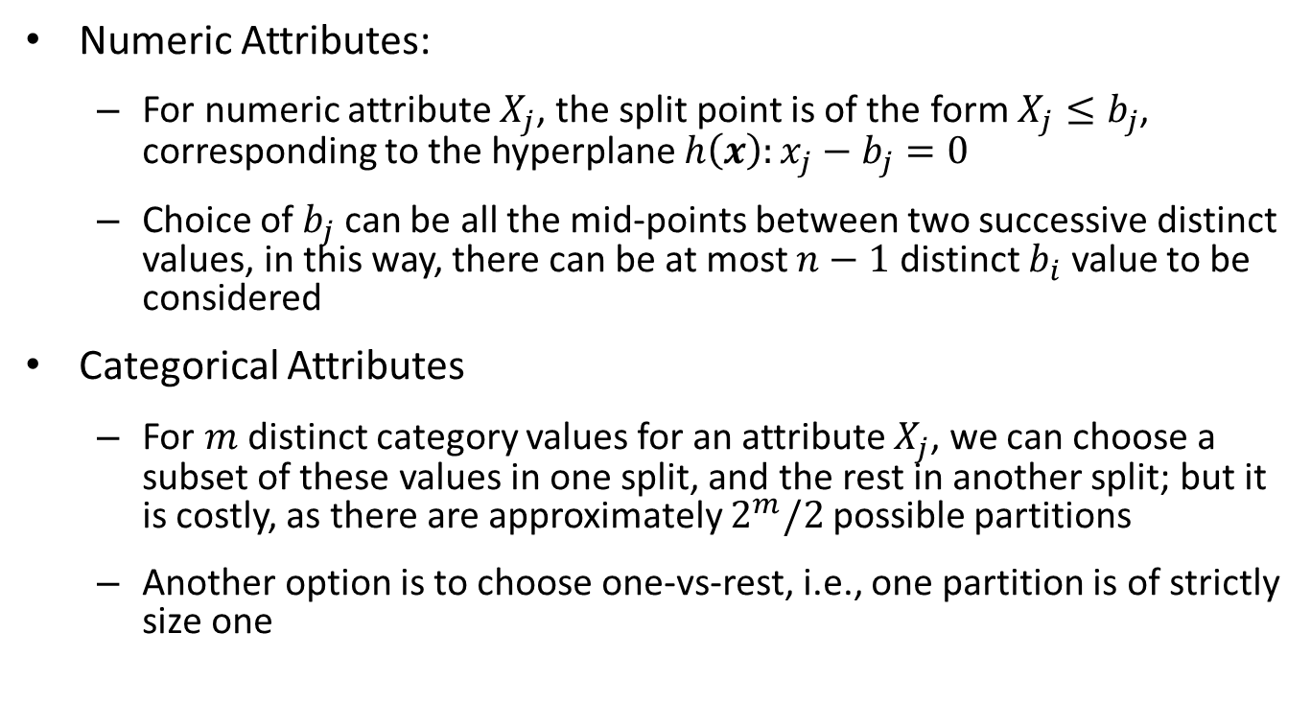
Enumerating Split-points
Numeric Attributes:
For numeric attribute $X_{j}$, the split point is of the form $X_{j}≤b_{j}$, corresponding to the hyperplane $h\left(x\right):x_{j}−b_{j}=0$
Choice of $b_{j}$ can be all the mid-points between two successive distinct values, in this way, there can be at most $n−1$ distinct $b_{i}$ value to be considered
Categorical Attributes
For $m$ distinct category values for an attribute $X_{j}$, we can choose a subset of these values in one split, and the rest in another split; but it is costly, as there are approximately $2^{m}/2$ possible partitions
Another option is to choose one-vs-rest, i.e., one partition is of strictly size one

Slide 8
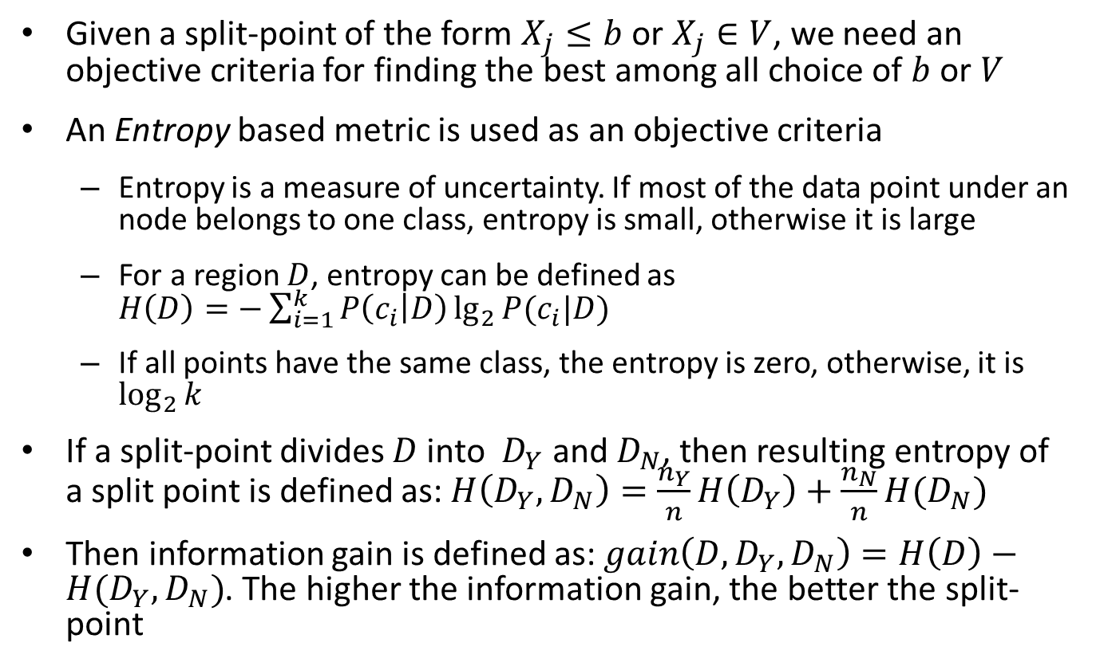
Evaluating Split-points
Given a split-point of the form $X_{j}≤b$ or $X_{j}∈V$, we need an objective criteria for finding the best among all choice of $b$ or $V$
An Entropy based metric is used as an objective criteria
Entropy is a measure of uncertainty. If most of the data point under an node belongs to one class, entropy is small, otherwise it is large
For a region $D$, entropy can be defined as $H\left(D\right)=−\sum_{i=1}^{k}{P\left(c_{i} | D\right)\lg_{2}{P(c_{i}|D)}}$
If all points have the same class, the entropy is zero, otherwise, it is $\log_{2}{k}$
If a split-point divides $D$ into $D_{Y}$ and $D_{N}$, then resulting entropy of a split point is defined as: $H\left(D_{Y},D_{N}\right)=\frac{n_{Y}}{n}H\left(D_{Y}\right)+\frac{n_{N}}{n}H(D_{N})$
Then information gain is defined as: $gain\left(D, D_{Y},D_{N}\right)=H\left(D\right)−H(D_{Y},D_{N})$. The higher the information gain, the better the split-point

Slide 9
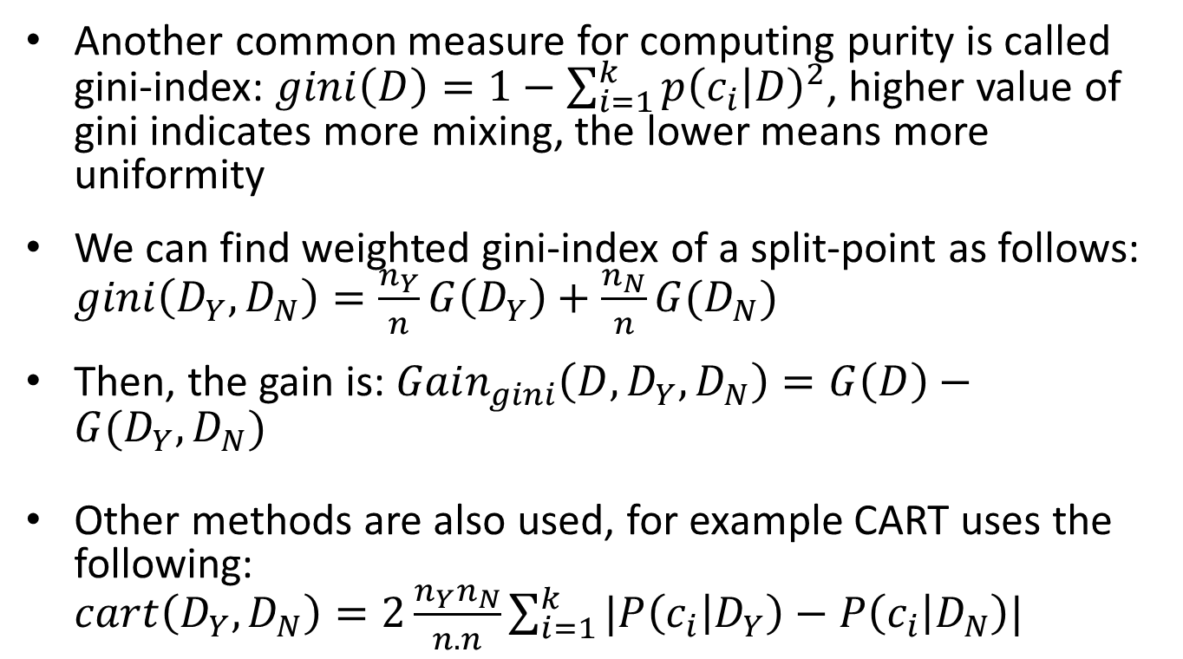
Evaluating split-points (cont.)
Another common measure for computing purity is called gini-index: $gini\left(D\right)=1−\sum_{i=1}^{k}{p{\left(c_{i} | D\right)}^{2}}$, higher value of gini indicates more mixing, the lower means more uniformity
We can find weighted gini-index of a split-point as follows: $gini\left(D_{Y},D_{N}\right)=\frac{n_{Y}}{n}G\left(D_{Y}\right)+\frac{n_{N}}{n}G(D_{N})$
Then, the gain is: $Gain_{gini}\left(D, D_{Y}, D_{N}\right)=G\left(D\right)−G(D_{Y}, D_{N})$
Other methods are also used, for example CART uses the following: $cart\left(D_{Y},D_{N}\right)=2\frac{n_{Y}n_{N}}{n.n}\sum_{i=1}^{k}{|P\left(c_{i} | D_{Y}\right)−P\left(c_{i} | D_{N}\right)|}$

Slide 10
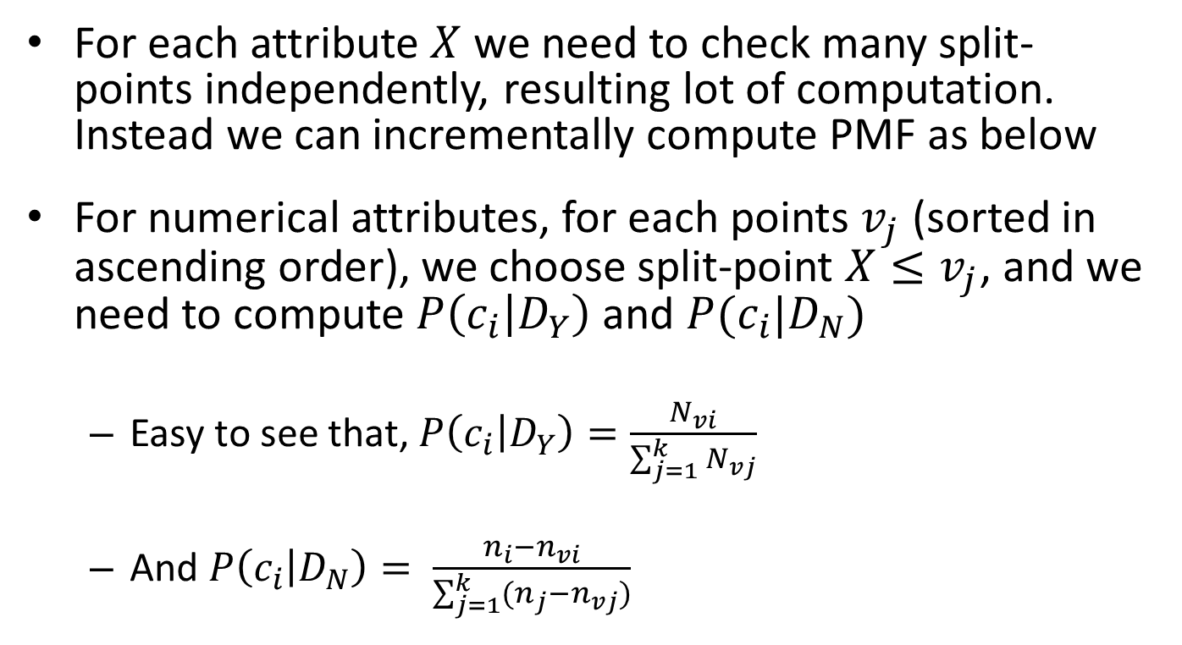
Estimating class probability mass function
For each attribute $X$ we need to check many split-points independently, resulting lot of computation. Instead we can incrementally compute PMF as below
For numerical attributes, for each points $v_{j}$ (sorted in ascending order), we choose split-point $X≤v_{j}$, and we need to compute $P\left(c_{i} | D_{Y}\right)$ and $P(c_{i}|D_{N})$
Easy to see that, $P\left(c_{i} | D_{Y}\right)=\frac{N_{vi}}{\sum_{j=1}^{k}{N_{vj}}}$
And $P\left(c_{i} | D_{N}\right)= \frac{n_{i}−n_{vi}}{\sum_{j=1}^{k}{(n_{j}−n_{vj})}}$

Slide 11
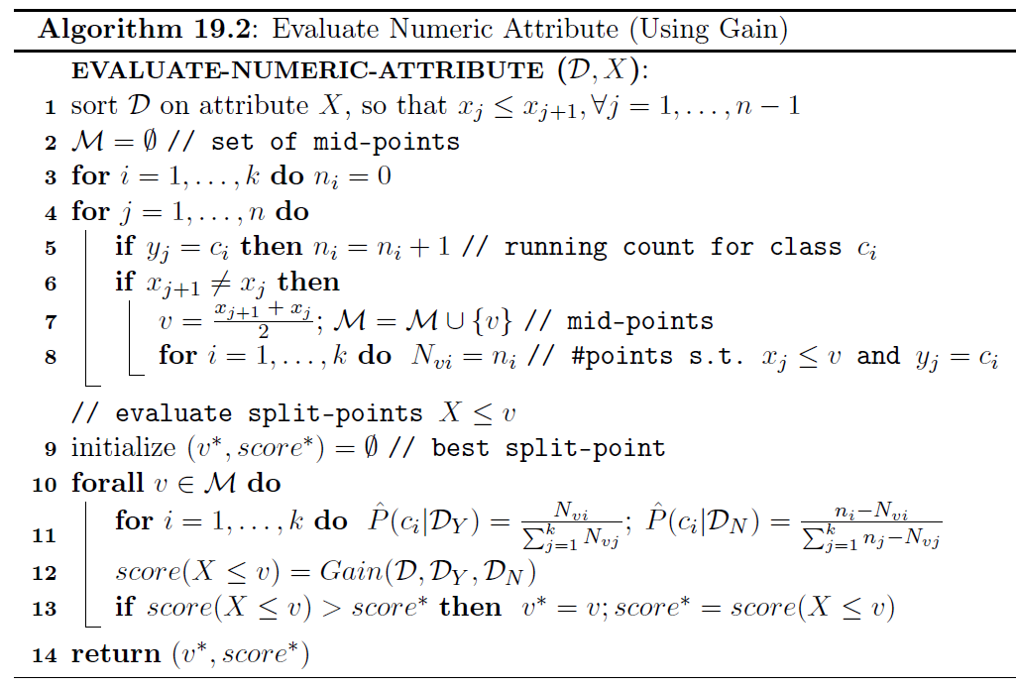
Evaluate Gain (numerical attribute)

Slide 12

Evaluate Gain (Category attribute)
$P\left(c_{i} | D_{Y}\right)=\frac{\sum_{v∈V}{n_{vi}}}{\sum_{j=1}^{k}{\sum_{v∈V}{n_{vj}}}}$
$P\left(c_{i} | D_{N}\right)=\frac{\sum_{v∉V}{n_{vi}}}{\sum_{j=1}^{k}{\sum_{v∉V}{n_{vj}}}}$

Slide 13
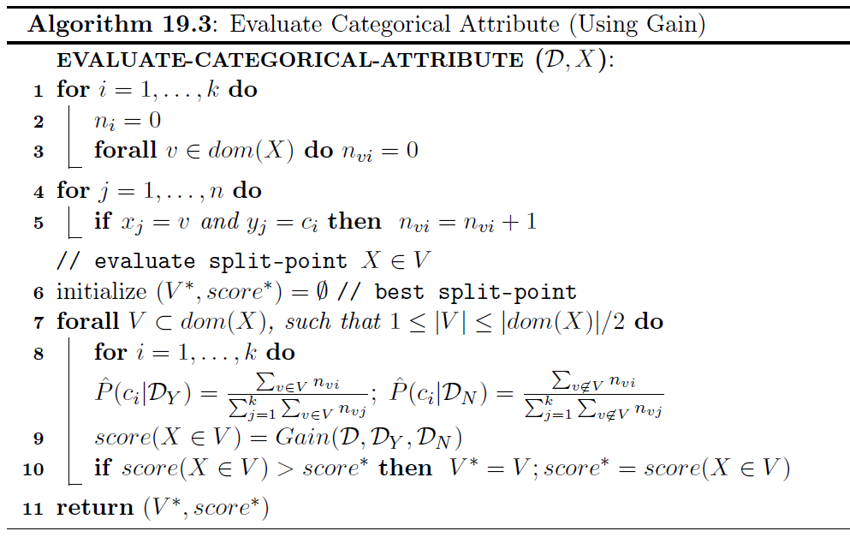
Algorithm

Slide 14
Stopping Criteria
When a leaf is pure
When the purity is above some threshold
Number of data points in a region is below some threshold
Or a combination of the above criteria

Slide 15
Example
Consider the dataset given below:
Id | Pressure | Size | Class
1 | low | fine | good
2 | low | fine | good
3 | medium | coarse | bad
4 | medium | coarse | bad
5 | medium | fine | good
6 | high | coarse | bad
7 | high | fine | bad
8 | high | fine | bad
9 | high | coarse | good
10 | high | fine | bad

Slide 16
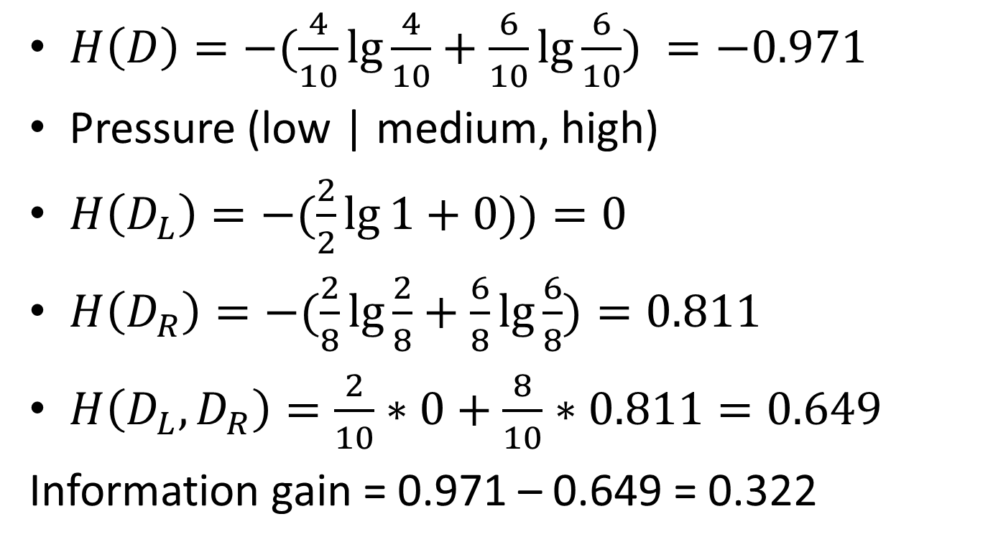
Example (cont.)
$H\left(D\right)=−(\frac{4}{10}\lg{\frac{4}{10}+\frac{6}{10}\lg{\frac{6}{10}) =−0.971}}$
Pressure (low | medium, high)
$H\left(D_{L}\right)=−(\frac{2}{2}\lg{1+0))=0}$
$H\left(D_{R}\right)=−(\frac{2}{8}\lg{\frac{2}{8}+\frac{6}{8}\lg{\frac{6}{8})=0.811}}$
$H\left(D_{L}, D_{R}\right)=\frac{2}{10}∗0+\frac{8}{10}∗0.811=0.649$
Information gain = 0.971 – 0.649 = 0.322

